Slide 1
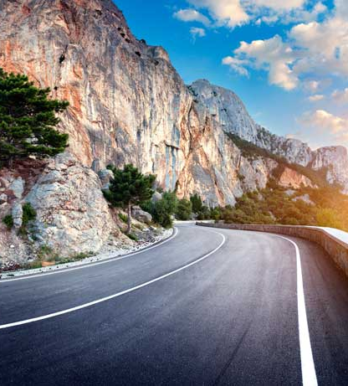
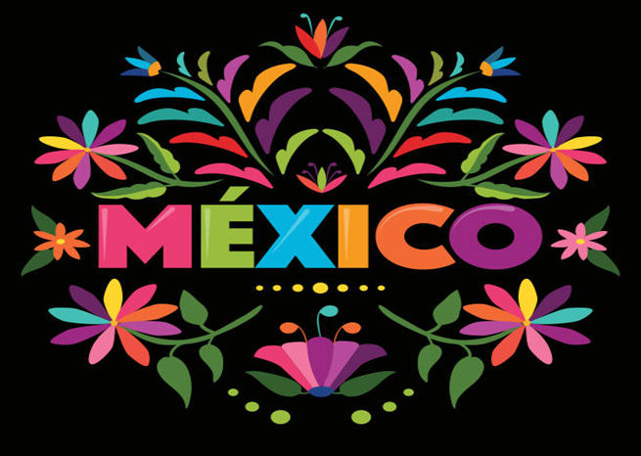
This Exhibit is to immerse you in the Culture and the Country. Mexico is more than tacos and dugs cartels. let’s get to know more about Mexico

Slide 2
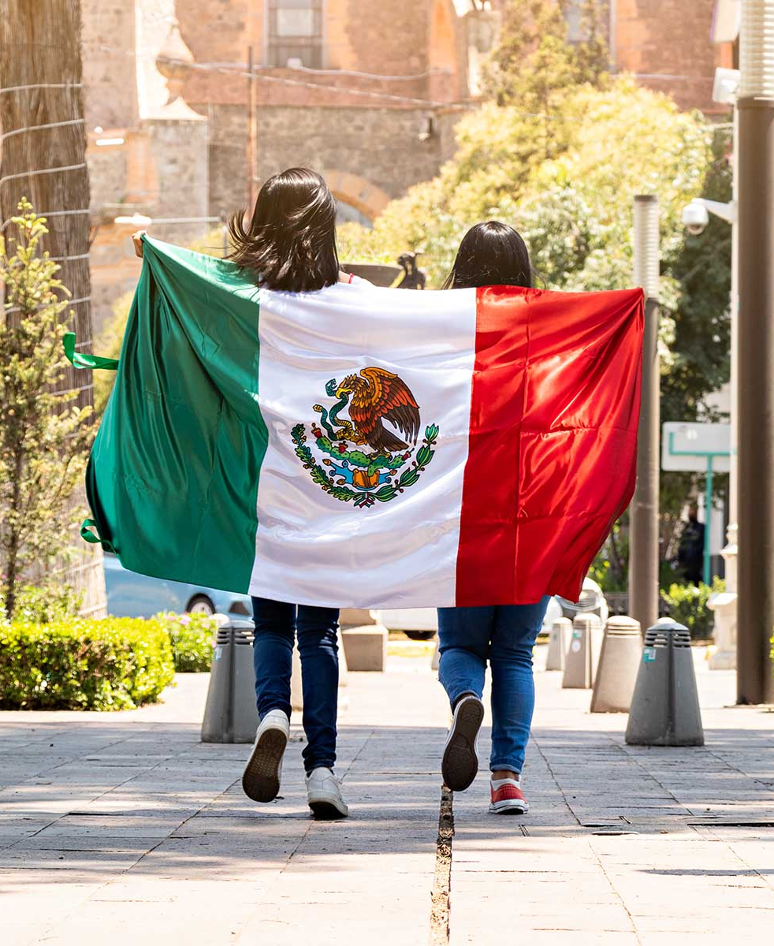
Design Principles
Balance and alignment
The weight can come from color, size, or texture. you can’t crowd all your heavy elements in one area of your composition
Contrast
Contrast is what people mean when they say a design “pops.”
Contrast creates space and difference between elements in your design.

Slide 3
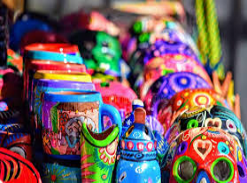
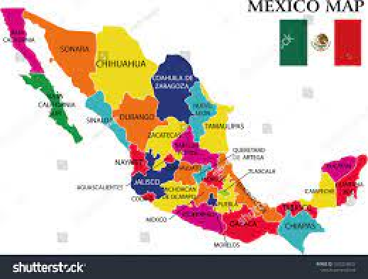
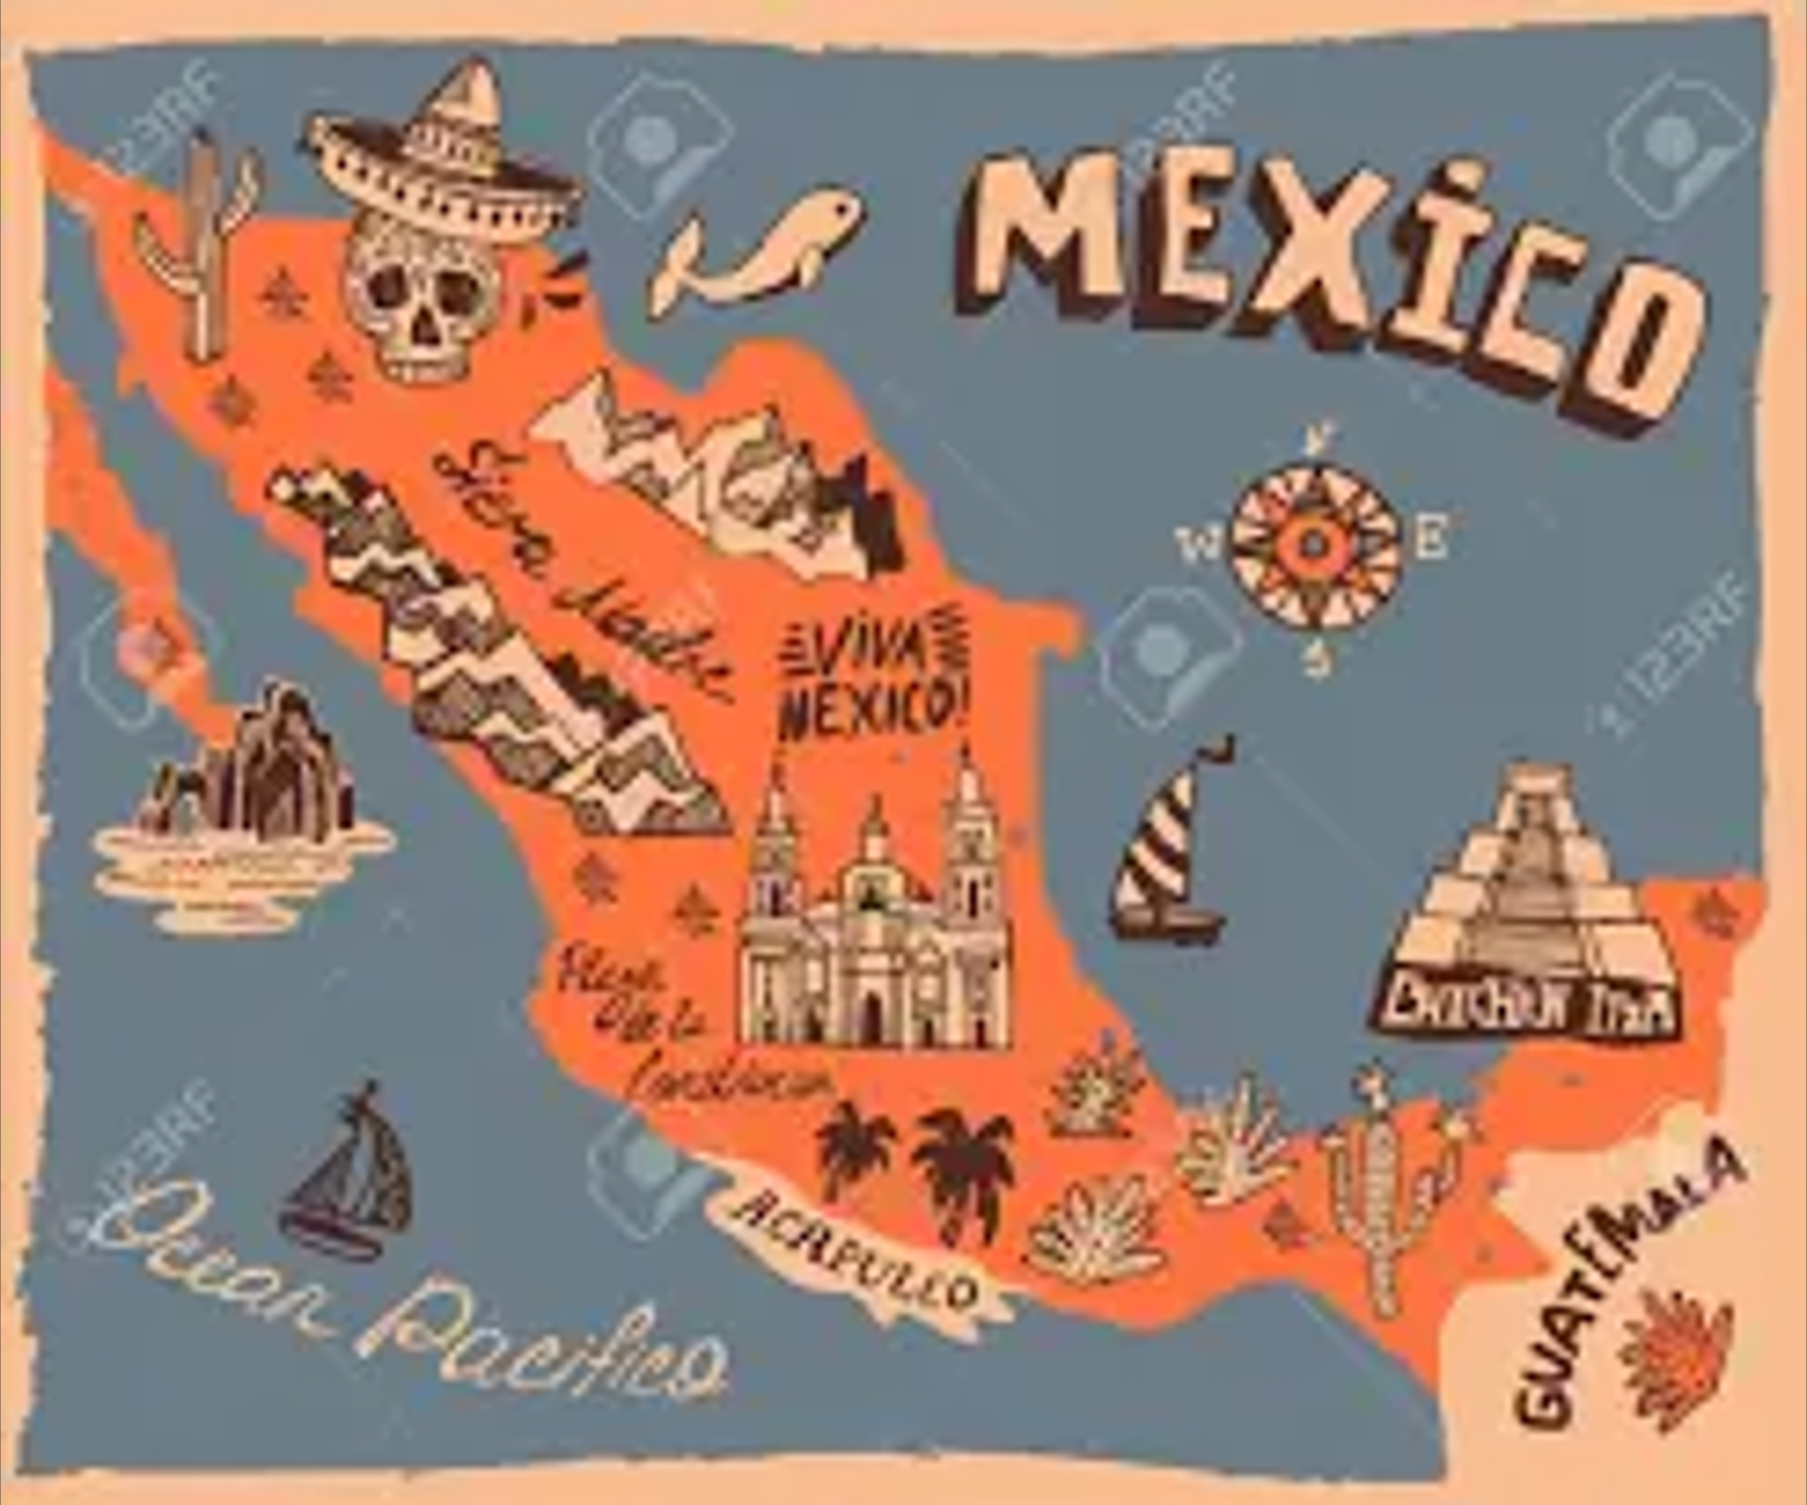
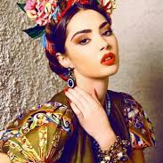
Mood Board
Mexico, officially the United Mexican States, is a country in the southern portion of North America. It is bordered to the north by the United States; to the south and west by the Pacific Ocean; to the southeast by Guatemala, Belize, and the Caribbean Sea; and to the east by the Gulf of Mexico

Slide 4
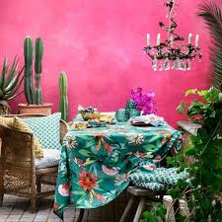
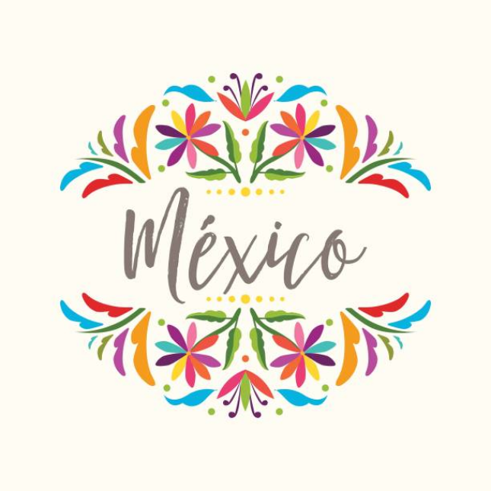
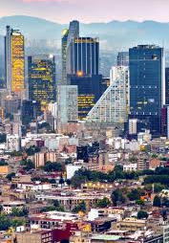
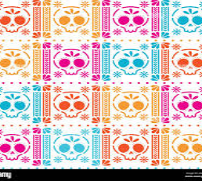
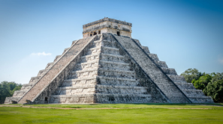
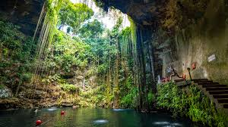
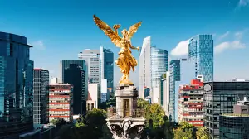
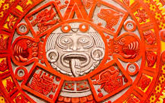
Slide title 7

Slide 5
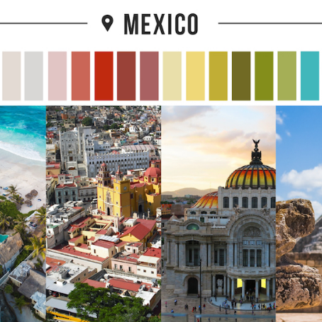
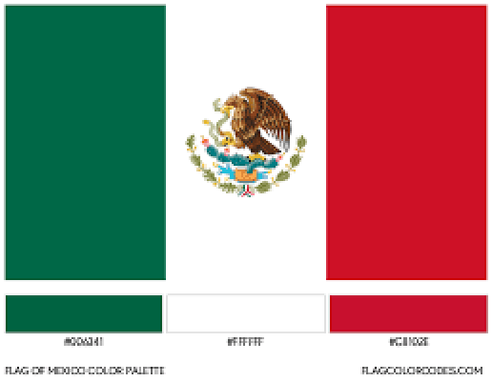
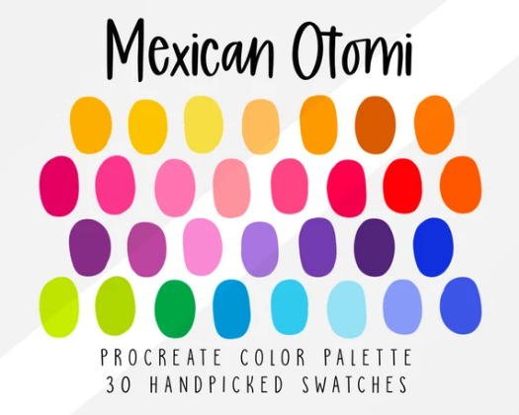
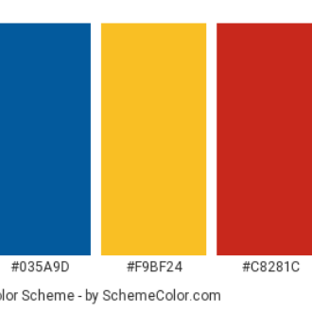
Color Chart

Slide 6
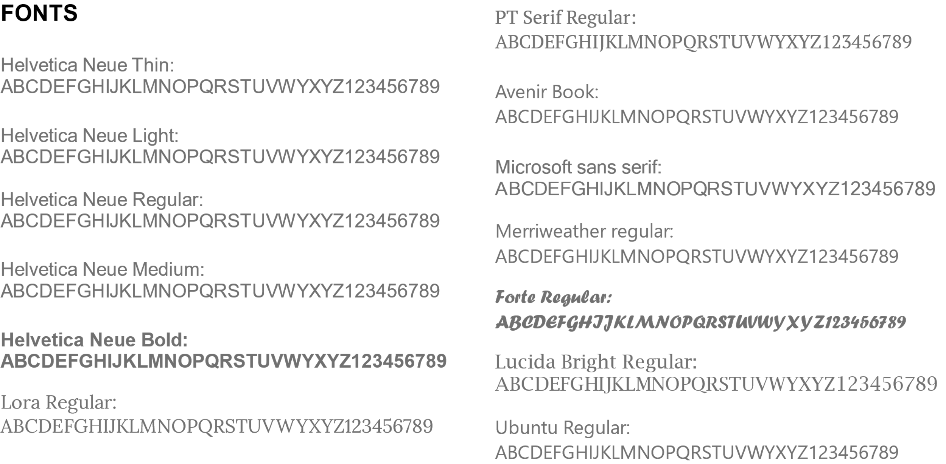
Typography

Slide 7
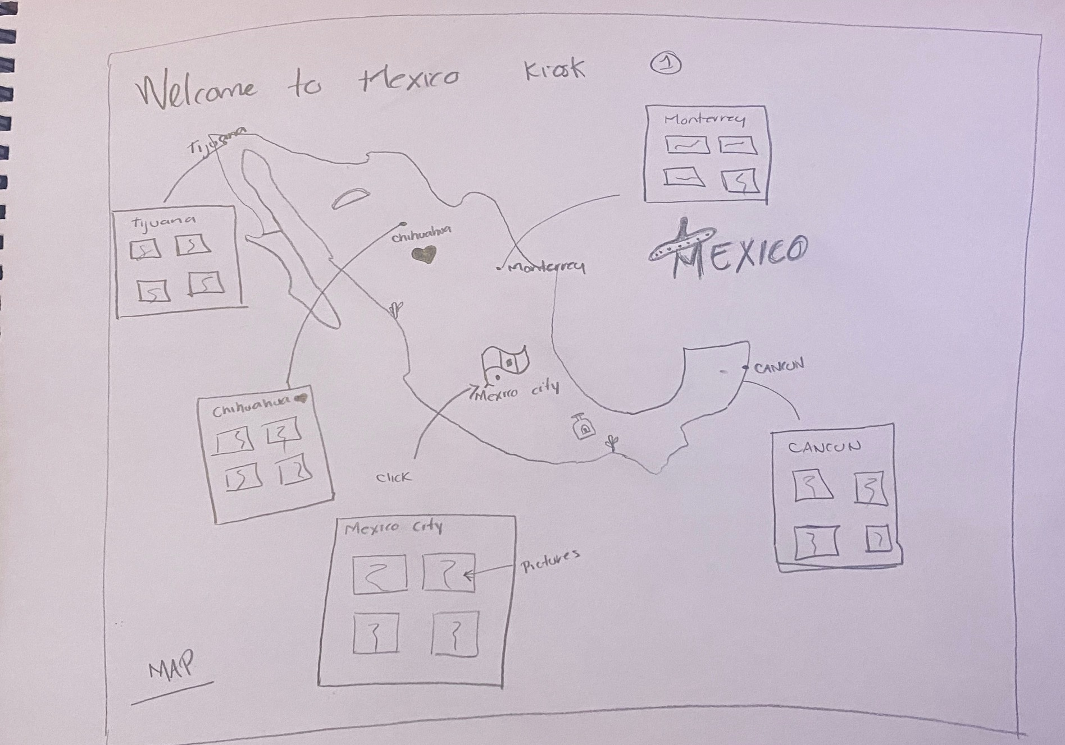
KIOSK 1

Slide 8
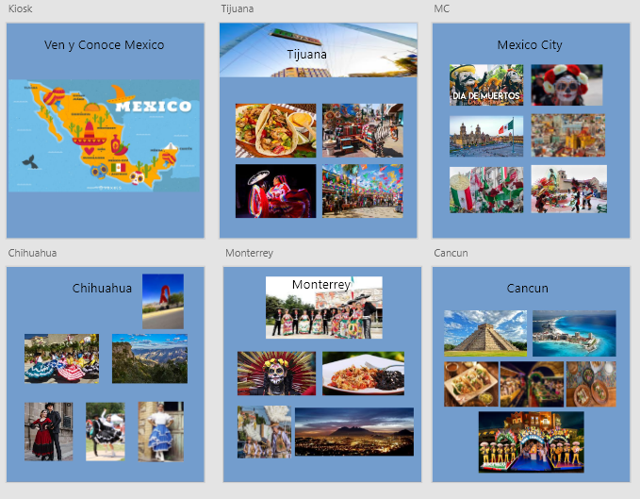
Kiosk 1

Slide 9
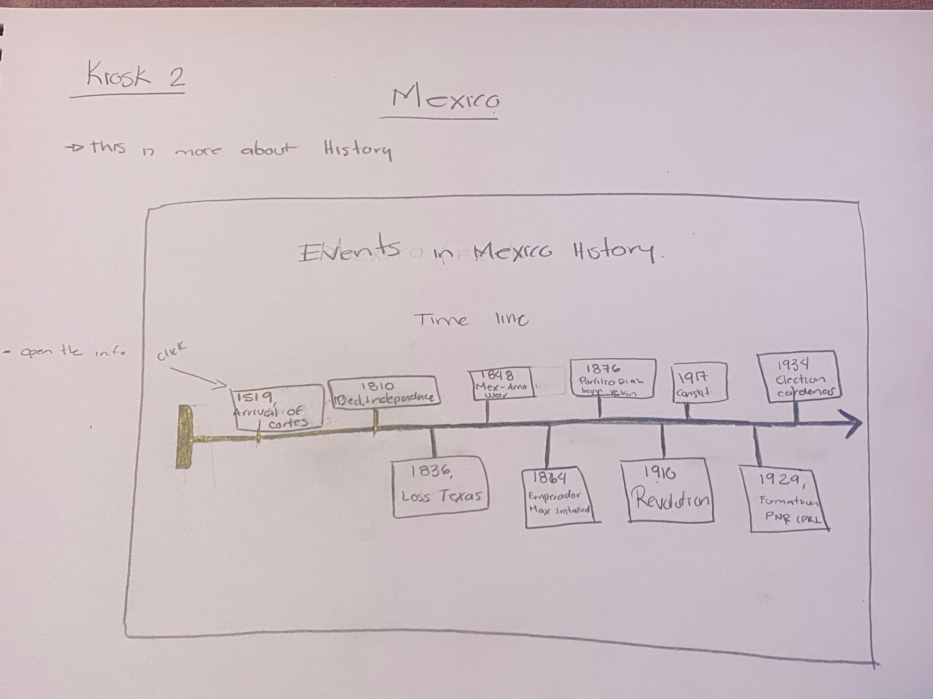
KIOSK 2

Slide 10
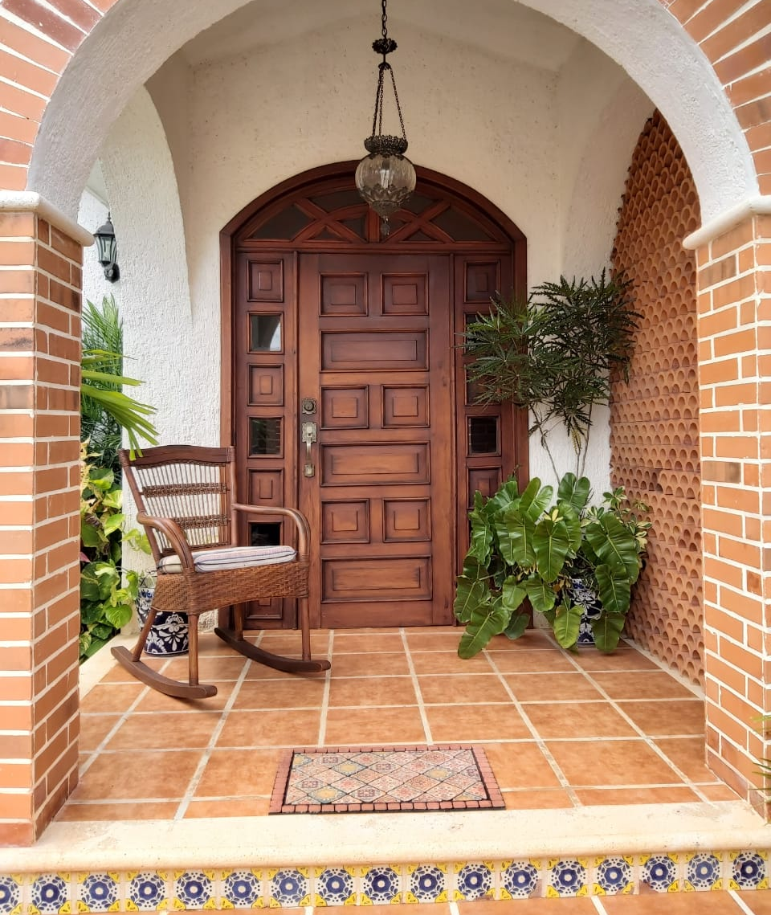
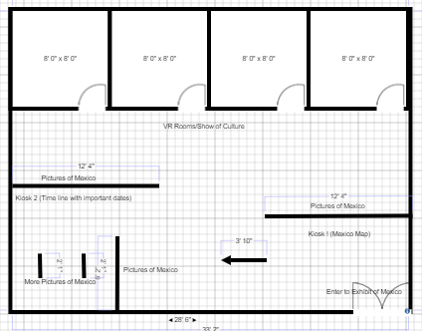
Exhibit Mexico
Top-Down Blueprint
Enter

Slide 11
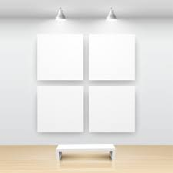
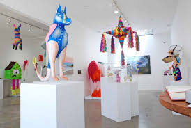
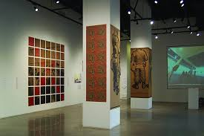
Exhibit
This part is just to show some pictures of the culture and will have some descriptions
Tall approx. 10 ft
All the pictures will be colorful
Depending on the pictures will be the color of the walls
Enter

Slide 12
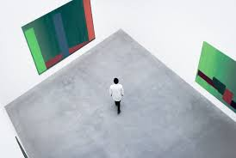
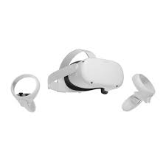
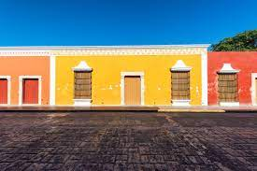
Vr Rooms
At the moment, you enter any of this rooms that will be some states with their own traditions or historical events.
You can be a guest or participant in the event (meaning if you enter a war, you can be a soldier) or tourist in a famous beach or place you want to visit
VR Rooms
This rooms will have multiples options:
History
Places to Visit
Cultural events
Visit States

Slide 13
Written Explanation
The Mexico exhibit is mostly to show the culture and the country not all the country is the same each state has their own culture and unique food. You can say they have their own language. The slag is different and the accent too.
Mexico is a country full of beautiful places, beaches, warm people, delicious food, and culture. Mexico is a country that sadly has some beautiful places, but they are a little dangerous to go. So, this project is to show all the country for those people that do not feel comfortable to go but they want to know more about.
I wont said that we do not have a drug cartels, bad people but we are more than that
In this exhibit I realize that it not just to have a great idea. The execution is important. The colors pallet is super colorful because Mexico is a very colorful country, and it is easy to combine strong colors without looking bad. They will be pictures showing the beauty and best places in Mexico without the crime. Crime is in every country so let's see the beauty and get educated in the culture.
The fonts are easy to read so that why I choose those one so it will be easy to read, all the craziness are in the walls color and pictures so the text should be easy to read.
Kiosks will show the different cultures, dances, food and language each state but mostly the History with their important dates.
VR rooms are the fun part of the exhibit because here you have like two options wit the headsets or just to see the pictures and listen to the music related to that room.
I am proud Mexican that I would like to show that my country is more than one place, we have modern cities, technology, beaches, museums, educated people, big universities. We are more than a person sitting in the desert with a big hat and a tequila bottle. we are more than a drunk or illegals or those bad things people said.

Slide 14
ESCAPE
the great

